Slide 1
Issue Tracker
Iteration 2
Team 1

Slide 2
Contents
Requirements
Software Architecture / Design
Implementation
Testing
Process Improvement

Slide 3
Requirements
Adding comment to an existing issue via a PUT request in the API.
Setting up Amazon S3 for storage of files / attachments.
Fixing bug in current project: Enable description editing.
Fixing previous backlog.

Slide 4
Software Architecture / Design
Use of Django Python Rest Framework to provide a web interface, handle requests and generate responses.
Adding a comment:
Originally comments could only be made through the project website
Goal this iteration: Functionality: to post a comment independently of viewing an issue
Understanding POST method
Created Serializer
Created View & ViewSet
Defining URIs
Testing code during this final stretch.

Slide 5
Amazon S3 remote file storage
AWS IAM setup
Created in new user cs673user in IAM section of AWS console, and created an access key for this user.

Slide 6
AWS S3 setup
Created a new S3 bucket called cs673 in AWS console
Modify the bucket policy of the cs673 bucket. Only cs673user has access. Access is made using cs673user within the Django app.
Add a cross-origin resource sharing (CORS) configuration allowing GET operation on bucket.
Modify settings file to add AWS access key credentials, static directory and media directory for S3 bucket.

Slide 7
Static & media file setup
Populate the static S3 cs673 bucket directory:
python manage.py collect static
Run the web application with the command:
python manage.py runserver 0.0.0.0:8000
Upload an attachment, and note its placement in S3 cs673 bucket media directory.

Slide 8
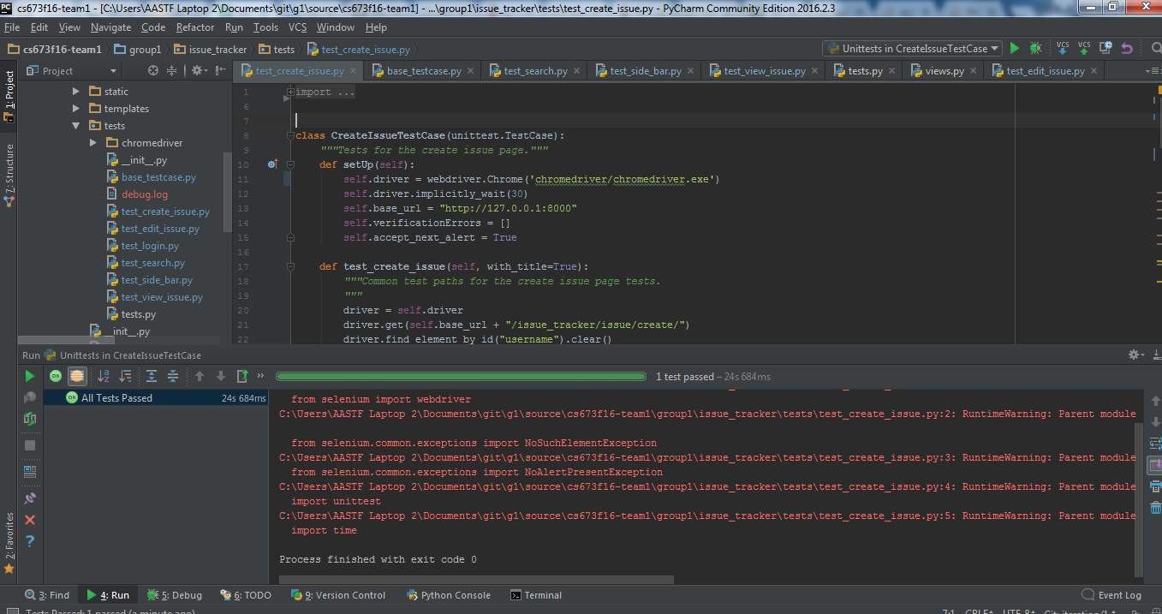
Testing
Current Testing Coverage:
6 UI Test Cases:
Create Issue Test Case is Automated, the rest is in progress.
All have manual test instructions as backup
Issues Faced this Iteration:
Update to Firefox web browser
Switched to Chrome web browser
Store ChromeDriver in app
Different implementations of existing Automation
Next Iteration
Refactor UI Automation
Add Unit Test Coverage

Slide 9
Process Improvement
Use of Paired Programming Approach for the less experienced members of the team.
Posting regular updates on Slack.
Assigning of tasks as per comfort level of technologies.

